Slide 1

Toxicology
Emergencies
Dr. hemal patel d.o.

Slide 2
Disclaimers
No financial or investment association with any medical companies
Opinions and information displayed herein are not representative statements of any organization

Slide 3
I NEED AN ADULT
1-800-222-1222

Slide 4
Treatments
99% of the time = Supportive Measures
But…..

Slide 5
Acetaminophen
Acetaminophen / Tylenol is metabolized into NAPQI (bad)
NAPQI is processed by Glutathione
Acute overdose depletes Glutathione
Chronic overdose also depletes Glutathione
NAPQI Build up -> Liver Failure

Slide 6
Acetaminophen
NAC = N-Acetyl-Cysteine = Antidote
NAC replenishes glutathione
Risky Populations
  Alcoholics
  Epileptics ( Seizure meds can speed up NAPQI production )
  Nutritionally deficient

Slide 7
Anticholinergics
Jimson Weed / Atropine / Benadryl / Anti-Histamines
HOT / Elevated body temp
DRY / Unable to sweat
BLIND / Dilated pupils
RED / Flushed skin
MAD / Delirious

Slide 8
Anticholinergics
Tachy, agitated, possibly hyperthermic
Supportive Measures
  Fluids
  Cooling
  Benzos

Slide 9
Botulism
Potent paralytic from bacterial toxin
Adults -> Poisoning, improperly canned foods, black tar heroin
  Difficulty swallowing, descending paralysis, respiratory failure
Babies -> Honey contains spores, no honey until >12 months
  Floppy, constipation, respiratory failure
Supportive Care
Antitoxin / Immunoglobulin available via CDC and poison control

Slide 10
Beta Blockers
Metoprolol / Atenolol / Carvedilol / Propranolol / -olol meds
Bradycardia
Hypotensive
Hypoglycemic

Slide 11
Beta Blockers
Supportive Measures
Atropine
Glucagon
Epi Drip
HIGH Dose Insulin Drip (1 – 10 units per Kilo per Hour)

Slide 12
Calcium Channel Blocker
Amlodipine / Nifedipine / Nicardipine / Clevidipine / Verapamil
Bradycardia
Hypotension
Hyperglycemia
Heart block

Slide 13
Calcium Channel Blocker
Supportive Measures
Atropine
Glucagon
Epi Drip
Calcium
HIGH Dose Insulin Drip (1 – 10 units per Kilo per Hour)
Lipid Infusion

Slide 14



Digoxin
Digoxin is less commonly used
Oleander
Foxglove
Lily of The valley

Slide 15
Digoxin
Toxic Ingestion
  Bradycardia
  PVCs
  Slow A fib
  Hypotension
Medical Use
  AV node blockade to slow down A Fib
  Improve heart contraction for Congestive Heart Failure

Slide 16
Digoxin
Supportive Care
External Pacing
Don’t give calcium / Stone Heart
Digibind
  Antidote to bind up digoxin and reduce toxicity

Slide 17
Carbon Monoxide
Confined spaces / Fires / Intentional
GI Distress
Normal Pulse Oximeter
Flu Like Illness in household
Headache / Weakness
Loss of Consciousness

Slide 18
Carbon Monoxide
Oxygen
High Pressure Oxygen aka Hyperbaric Chamber
Co-Ingestion
  Burning Polyurethanes (Insulating foams, synthetic flooring, car trim, seats) = Cyanide Production

Slide 19
Cyanide / Cellular Asphyxiants
Potent poison
Used in gold mining, industrial chemistry
Accidental release during combustion (Insulating foams, synthetic flooring, car trim, seats)
Apricot / Peach pits (need to eat A LOT)
Defeats body's ability to use oxygen for energy

Slide 20
Cyanide / Cellular Asphyxiants
Syncope
Seizure
Coma
Cardiac Arrest
Treatment
  Cyanokit (Hydroxocobalamin) Injection -> Binds cyanide to turn into B12
  Sodium Thiosulfate

Slide 21
Clonidine / Imidazolines
Clonidine / Guanfacine / (Oxymetazoline / Tetrahydrozoline / Naphazoline eye drops)
Opioid like
  Lethargy
  Respiratory Depression
  Bradycardia
Supportive Measures
Narcan

Slide 22
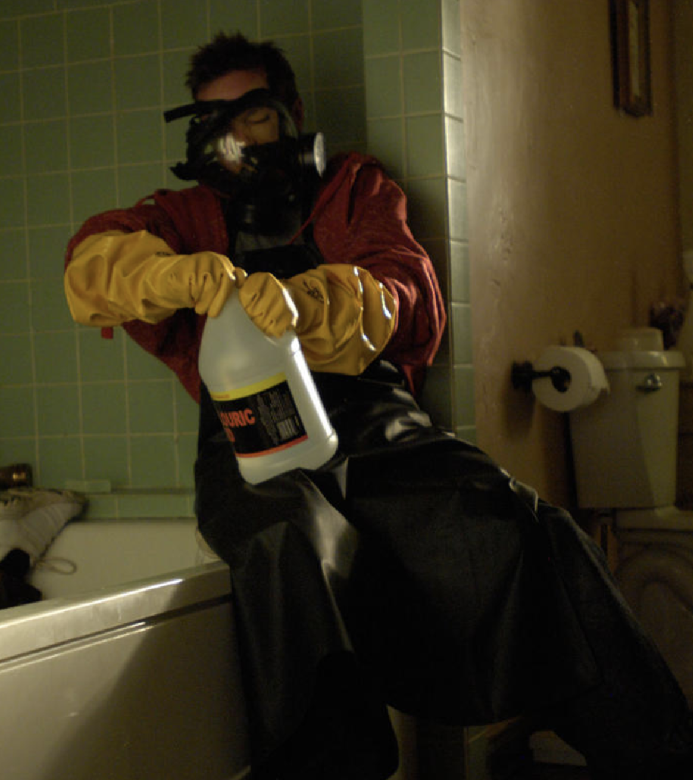
Hydrofluoric Acid
Glass etching / Brick Cleaners / Rust Removers
Exposure to skin = Pain out of proportion
Annihilates body calcium stores
Toxicity
  Hypocalcemia
  Hyperkalemia
  QTc Prolongation -> Vtach

Slide 23
Hydrofluoric Acid
Topical calcium gel
IV Calcium / Large Doses
Aggressive treatment of Hyperkalemia
Significant body exposure leads to death due to electrolyte disturbances

Slide 24
Iron
Leading cause of death in pediatric ingestions
Elemental iron dose is key
20mg / kg = Toxic
60mg / kg = lethal

Slide 25
Iron
Stage I - > GI upset, vomiting blood
Stage II -> Are we we maybe okay?
Stage III -> No, multi organ failure
Stage IV -> Recovery with GI scarring OR Death

Slide 26
Iron
Charcoal does nothing
Early bowel irrigation prevents some absorption
Antidote for toxic levels = Deforxamine

Slide 27
Lithium
Commonly used medication for bipolar disorder / mood disorders
Nausea / Vomiting / Diarrhea
Coma, Convulsions, Tremors
Bradycardia, T wave inversions

Slide 28
Lithium
IVF. / Hydration
Charcoal does nothing
Urinate or Dialysis
Wide Volume of Distribution

Slide 29


Mushrooms
Edible vs Toxic vs Fatal
Nausea, vomiting, diarrhea before 6 hours = Good
Classic “death cap” is similar to Tylenol toxicity

Slide 30
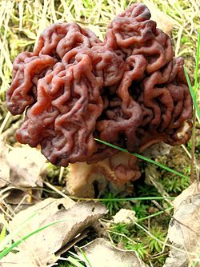
Mushrooms
Treatment
  N-Acetyl Cysteine
  Supportive Care
  Liver Transplant
Psilocybin / Magic Mushrooms = Supportive care, benzos
False Morel / Gyromitra = Vitamin B6 and methylene blue
  Can be edible based on species and method of preparation

Slide 31
Aspirin
Uncouples Oxidative Phosphorylation = Cells ability to use oxygen is reduced
Nausea / Vomiting
Pulmonary / Cerebral Edema
Tachypnea / Tachycardia
Hyperthermic
Delirium
Lethargy

Slide 32
Aspirin
Charcoal DOES Work
Whole bowel irrigation
Sodium bicarb infusion
  Helps kidneys remove aspirin
Dialysis
Supportive Measures

Slide 33
Benzodiazepines
Alprazolam / Lorazepam / Diazepam / Clonazepam / -pam
Sleepy but rarely interferes with breathing
  Combination of drugs can impair respiration
Supportive Measures
Do not use antidote

Slide 34
Serotonin Syndrome
Typically caused by overdose of anti-depressant medications or new use of multiple medications
MAOIs (Rarely used) – Phenelzine, Selegiline, Safinamide
SSRI (Common) – Citalopram, Escitalopram, Fluoxetine, Paroxetine, Sertraline
TCA – Amitriptyline, Nortriptyline, Doxepin, Desipramine
Lithium
Detromethorphan (Cough Syrup)

Slide 35
Serotonin Syndrome
Altered Mental
Rigid extremities
Hyperthermia
Tremors
Treatment = Supportive Measures, Benzos

Slide 36
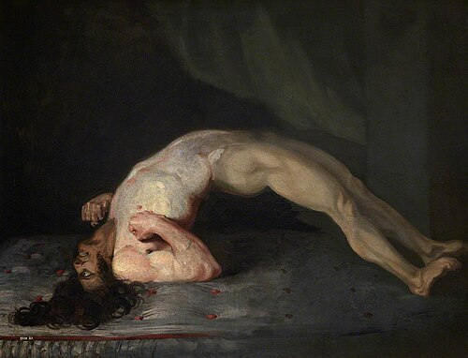
Strychnine
Gopher Poison / Rodent poison
Similar to Tetanus Toxin mechanism
Inhibits Glycine
Agitation / Myoclonus (Stiff) / Opisthotonus =
Peripheral Convulsions
Normal Mental status

Slide 37
Strychnine
Treatment = Supportive Measures
Benzos
Paralyze

Slide 38
EMS Considerations
If possible bring the bottle
Time of ingestion is helpful
There is no maximum dose of benzodiazepine
Scoop and Run
You can do everything right and still lose

Slide 39
Questions?

